Slide 1
News Classification
&
Summarization
Group#6

Slide 2
Meet Our Team
Fatima Aghapourasl
Kareem Albeetar
Chun Lam Cheung
Penelope De Freitas
Eltigani Hamadelniel
Yi Liu
Jeffrey Ching Lok Ng
Ivy Tsai

Slide 3
01
Project Motivation
Presentation
Overview
02
Methodology
03
Data Acquisition
04
Data Preprocessing
05
Classification Models
06
Summarization Models
07
Progress & Next Steps
08
Preliminary Conclusions

Slide 4
Project Motivation
Scope: News classification and summarization of articles.
Classifying and summarizing news data in the real world provides several benefits:
Reduces Information overload
Improves Efficiency
Offers Personalization
Supports Decision-making and Monitoring

Slide 5
Methodology
News
Article
Article
Scrapper
Data
Preprocess
Summary
Summarizer
Category Classifier

Slide 6
Methodology
Acquire News Articles
categories, articles, summaries
Tasks were split into sub-groups
Concentrated on three popular news categories: Entertainment, Sports, Business & Other
Each sub-group worked with different models for classification and summarization
Optimizing Hyper-parameters e.g. learning rate, batch size, activation function, etc.
Evaluation Metrics e.g. accuracy, f1 score, training loss, validation loss, rouge
Results and techniques were compared within larger group discussions

Slide 7



Data Acquisition
Web Scraper

Slide 8
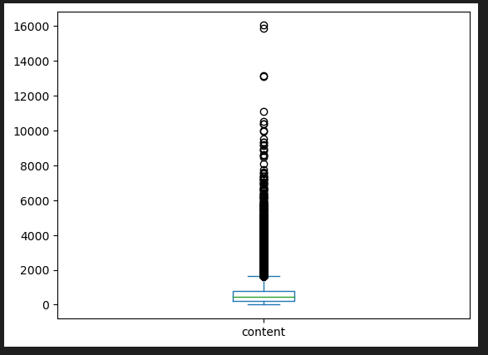
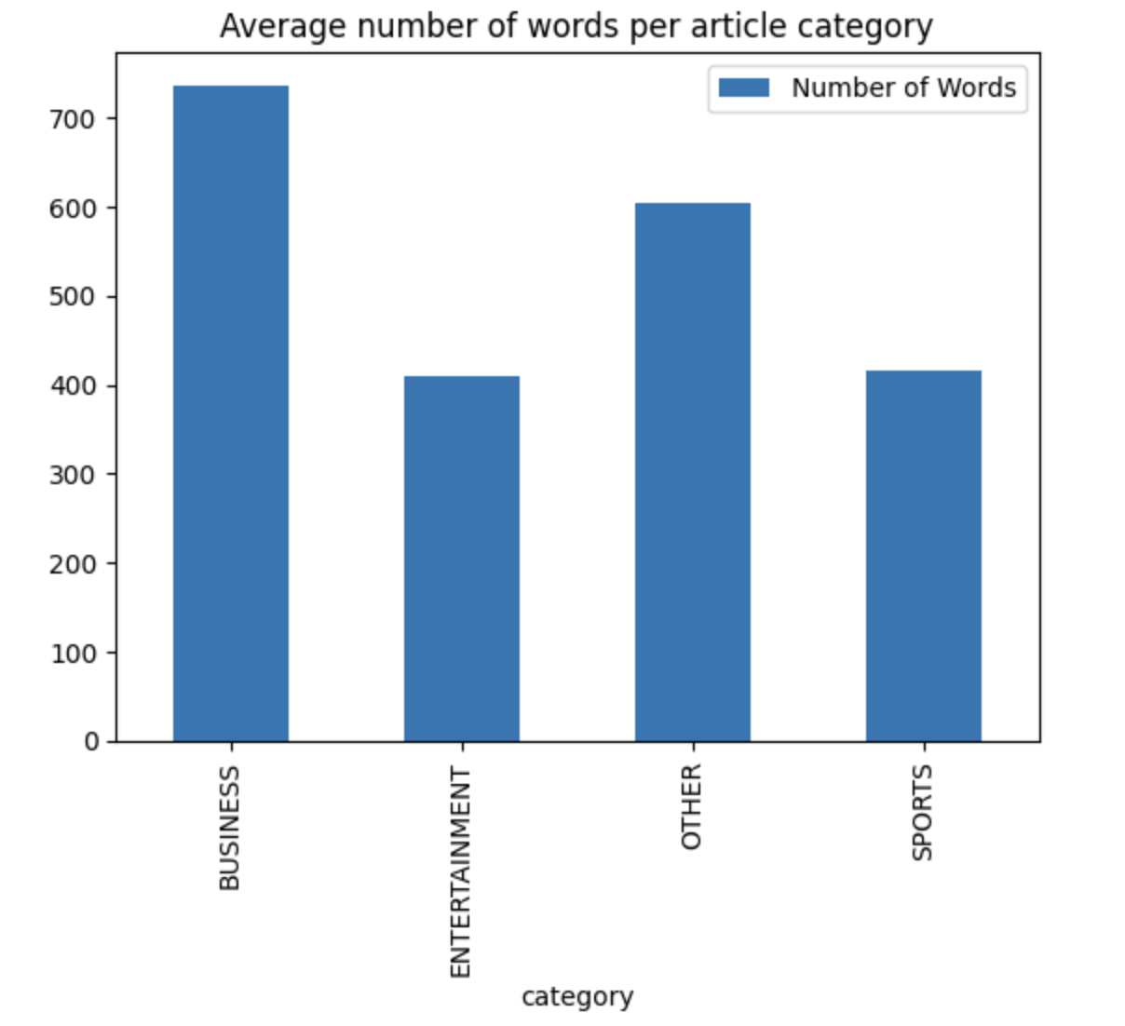
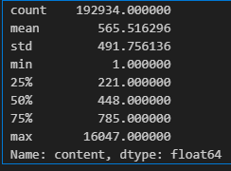
News Categories Dataset
Features:
Headline
Short Description
Authors
Target:
News Article Category
Date
Content
Link
For the classification task we used a single dataset with 210000 data
This data contained category, url, and short description
We decided to scrape the data from the url to get the full article
After cleaning broken links we were left with 193k data
There were a total of 42 categories, in which we focused on sports, entertainment and business

Slide 9
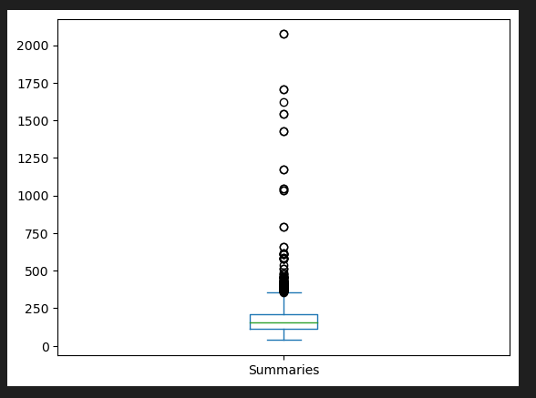
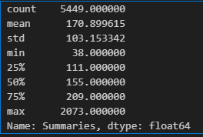
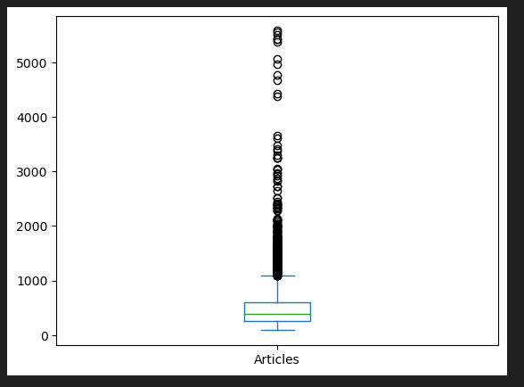
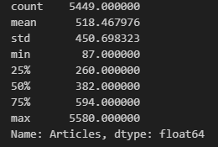
News Article Summary Dataset
Features:
Category
Articles
Target:
News Article Summary
For the summarization task we combined a few different datasets with articles summaries totaling ~5500 data.
This data contained category, article, and summary
Summaries were handwritten
Article
Summary

Slide 10
Data Preprocessing
Classification Dataset:
Remove null values and duplicates if found
we investigated more into why there were so many articles with and low word count (< 75)
Most of these articles were about tweets and videos
Remove stopword and punctuation
Summarization Dataset:
Merge the summarization datasets
Remove null values and duplicates if found

Slide 11
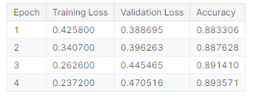
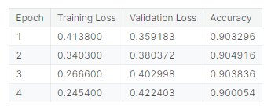
Category Classification
Models: DistilBERT and DistilRoBERTa
4 classes: Sports, Entertainment, Business, Other
Unbalanced dataset, ~16000 for Entertainment, ~4400 for Sports, ~ 5100 for Business, and ~160000 for Other
Used undersample to achieve ~4200 data for each category
Accuracy scores were relatively similar between the two models
DistilBERT
DistilRoBERTa

Slide 12
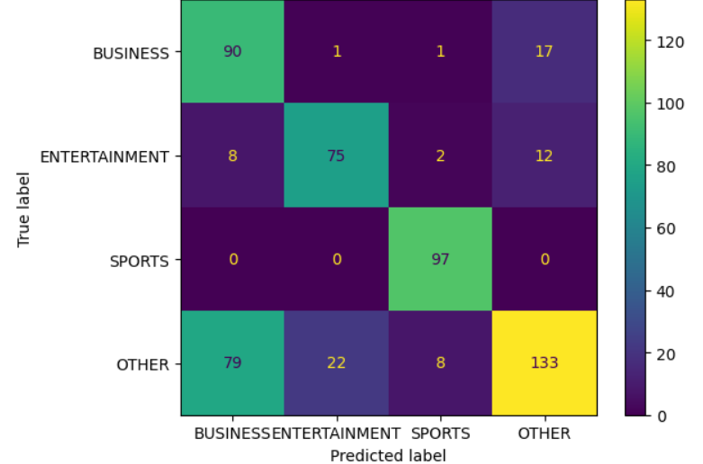
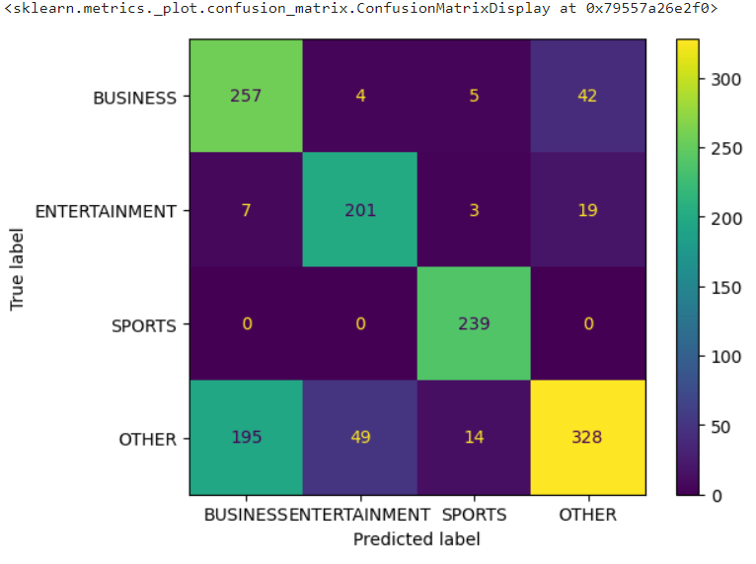
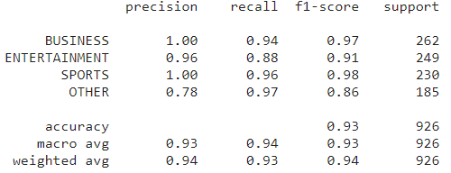
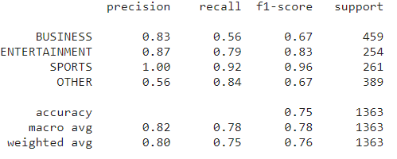
Classification
Validation Set
Summary Set

Slide 13
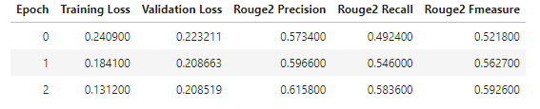
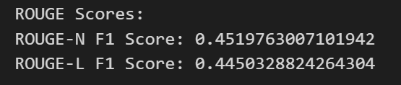
Summarization - General
Models: Longformer vs T5-base
Maximum of 3 epochs
Evaluation Metrics: Rouge
Longformer - 161M parameters
Hand written summary:
But Ms Short said the effect of the parallel coalition would be to undermine the UN.She said only the UN had the "moral authority" to lead the relief work.The US was "very bad at coordinating with anyone" and India had its own problems, Ms Short said.Ms Short said the countries involved could not boast good records on their response to major disasters.Former Cabinet minister Clare Short has criticised the US-led tsunami aid coalition, saying the UN should be leading efforts.
T5-base Generated summary:
Former Cabinet minister Clare Short has criticised the US-led tsunami aid coalition, saying the UN should be leading efforts.President Bush has announced that an alliance of the US, India, Australia and Japan will co-ordinate a humanitarian drive.I think this initiative from America to set up four countries claiming to co-ordinate sounds like yet another attempt to undermine the UN when it is the best system we have got
Longformer Generated summary:
Ms Short also said that the US was very bad at coordination with anyone' and India Had its Own problems, Mr Short said."But MsShort said The effect of a parallel coalition will be to undercut the UN," she said.Former cabinet minister Clare short has criticised THE US-Led tsunami aid Coalition, sayingThe UN should being leading efforts .

Slide 14
Summarization - Business
Models: T5-base vs. BART
Maximum of 3 epochs, small batch sizes of 4, 8
Evaluation Metrics: Accuracy, F1 Score, Training Loss, Rouge
Preliminary results:
Metrics | T5-base | BART
Accuracy | 0.9224 | ~0.66
F1 Score | 0.9218 | ~0.67
Average Loss | ~ 0.4249 | ~ 0.4147
Rouge | TBD | TBD

Slide 15
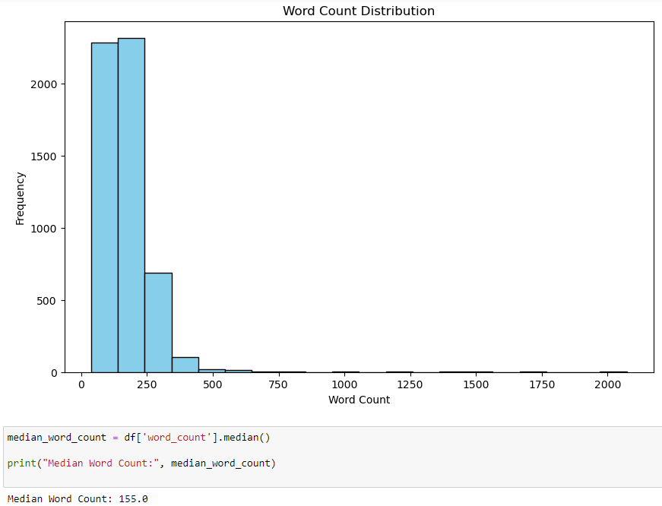
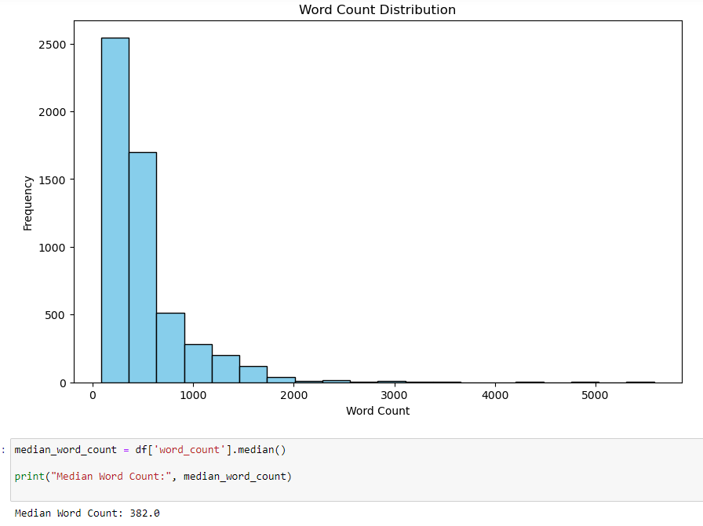
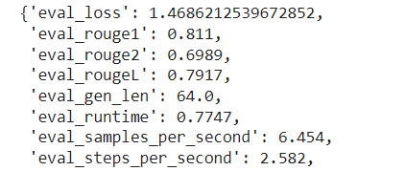
Summarization - Sports
Models: BART and T5
Low initial accuracy in default BART
Epoch = 3; Batch size =4 & 8
Input max length: article = 382 ; summary = 155
Output max length = 155
Finished: BART model hyperparameter tuning
On-going: T5 hyperparameter tuning and evaluation
Use a random generated article to evaluate summarization quality BART & T5
BART example output
T5 example output
Dataset Distribution

Slide 16
Summarization - Entertainment
Models: Bart-base VS T5-base
Training within 1-10 epochs , Batch size: 4, 16, 32 , Max Length Word:512, 1024
Metrics | Bart-base | T5-base
Rouge-1 | 0.79 | 0.94
Rouge-2 | 0.64 | 0.89
General Summary:As a Financial Coaching Corps volunteer Ms Davis is among 2 500 volunteers in the Retired and Senior Volunteer Program sponsored by Community Service Society one of the eight organizations supported by The New York Times Neediest Cases Fund…
Bart Prediction:On an October day Anne Davis 76 wheeled into her Midtown Manhattan cubicle wearing a bright red coat with her hair cut short and took a turn at a sharp angle to reach her desk Ms Davis has not walked in 30 years about a decade after she was told she had multiple sclerosis And then in 2003..
T5-base Prediction: on Fridays French lessons and volunteers her legal services at the New York City chapter of the National Multiple Sclerosis Society her work with the Financial Coaching Corps is more than having something to do on Fridays Volunteers like Ms Perez check whether people qualify for benefits assist them in the application …

Slide 17
Progress & Next Steps
Make sure all models use the same evaluation metrics for summarization
Compare the metrics across the various models
Compare the quality of summaries produced by the various models
Change loss function for summary to try to include a grammar score
Further fine-tune BART for business news summarization
Add data from a variety of different news sources for the classification model
Fine-tine for the generation() function
Parameter: num_beams, early_stopping, Length_penalty

Slide 18
Preliminary Conclusion
Classifying and summarizing news data:
provide valuable tools for managing information and staying informed
has implications for various stakeholders
plays a crucial role in leveraging data for actionable insights
Pre-trained deep learning models are powerful foundation tools
This project holds the potential to make a difference in supporting individuals, organizations, and society as a whole

Slide 19
DEMO
Notes:
Feedback:
Add base model to compare. Try to use different families of models. Highlighting keywords differences is good. Showcase the parameters that we changed and experimented with. Why did the model predict much more business on the summary set.

